Slide 1

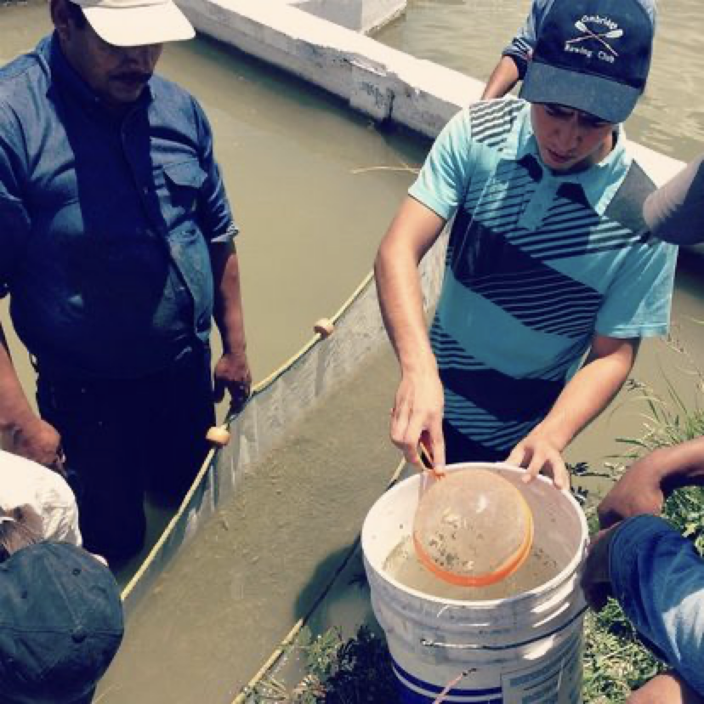
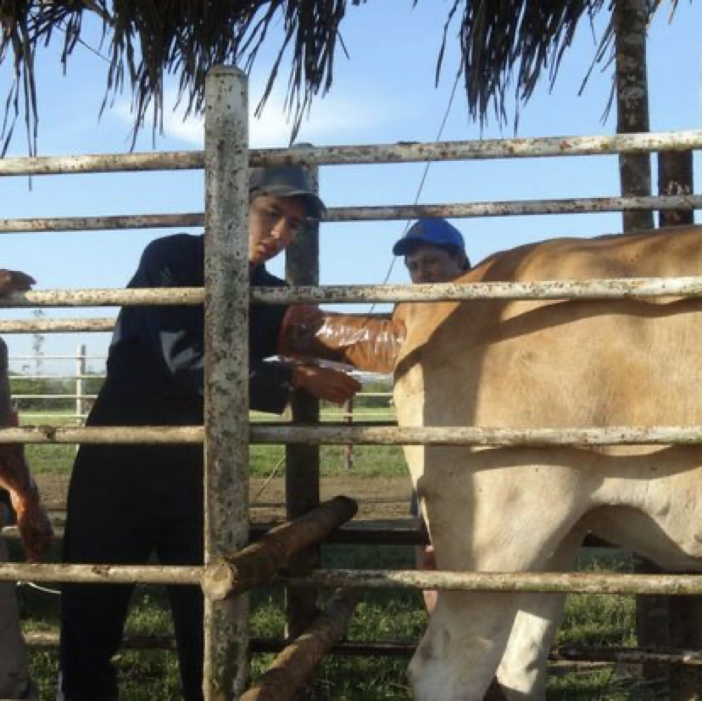
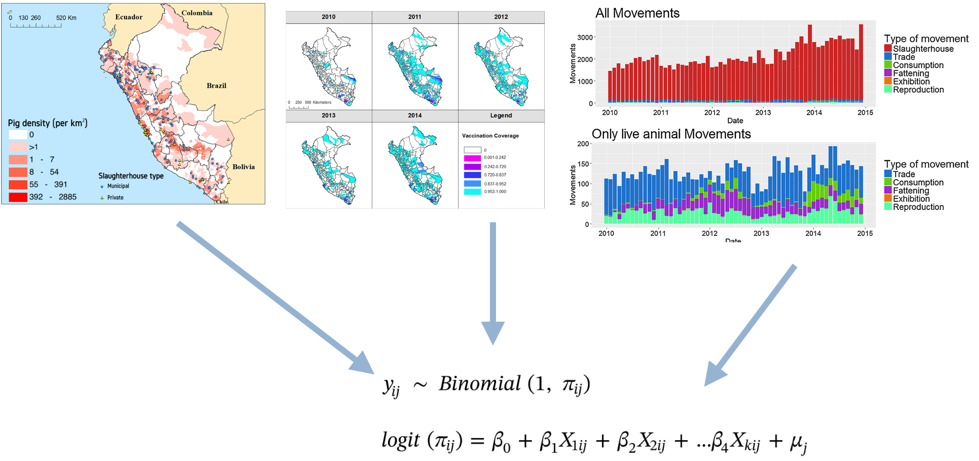
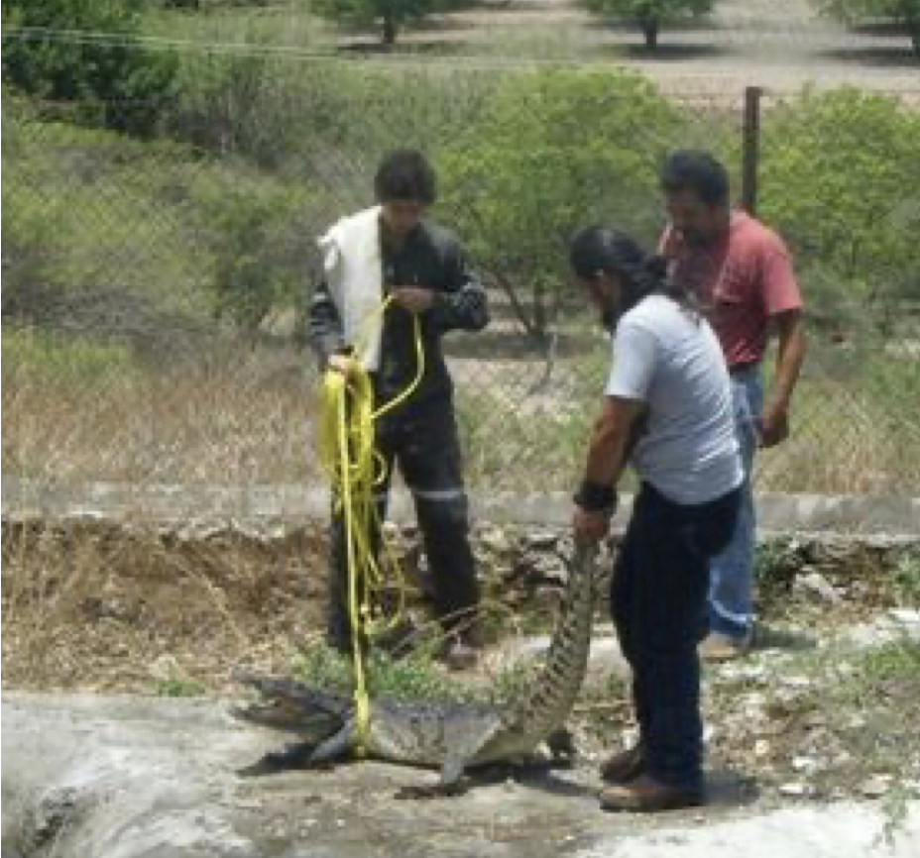
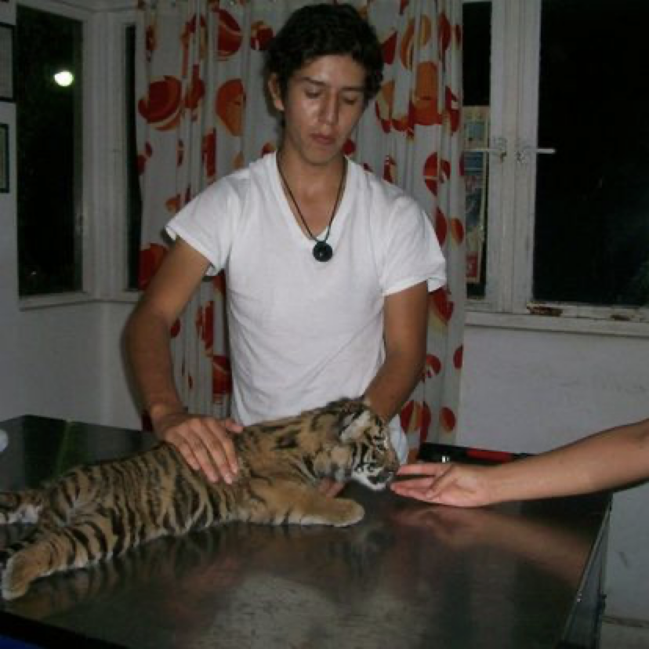
DVM (2010-2015)
MPVM (2016-2017)
Notes:
Background I consider myself a research epidemiologist, I started this journey
- Vet school in Mx, I had the opportunity to do some volunteer wokr and short term jobs, lots of exploration in wildlife and exotic animals, production animals, lab work (bacteriology and pathology), clinics, research
- MPVM, it really changed my perspective of what I wanted to do for living. I started get more interest in epidemiology and methods. The program was a nice intro to stats and modeling, and for my project I did some work for the national vet services of Peru so i got a bit of experience working with non-academic institutions.

Slide 2

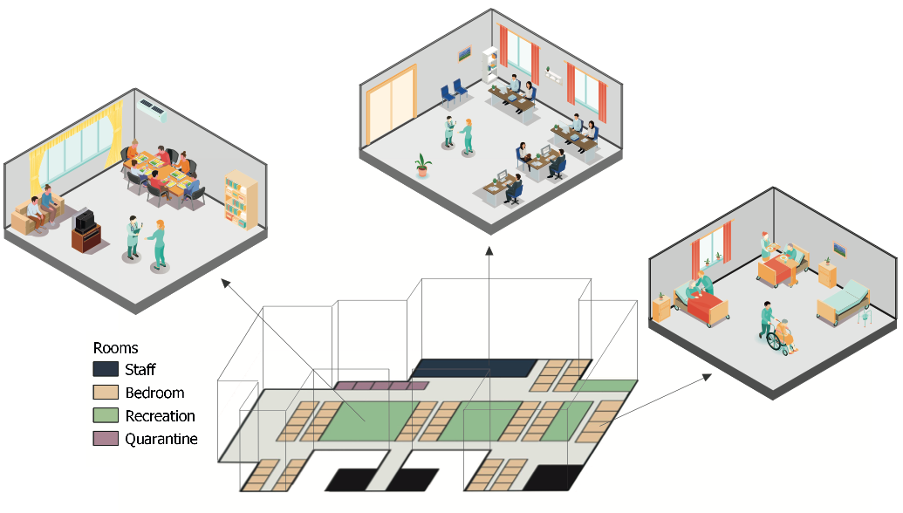
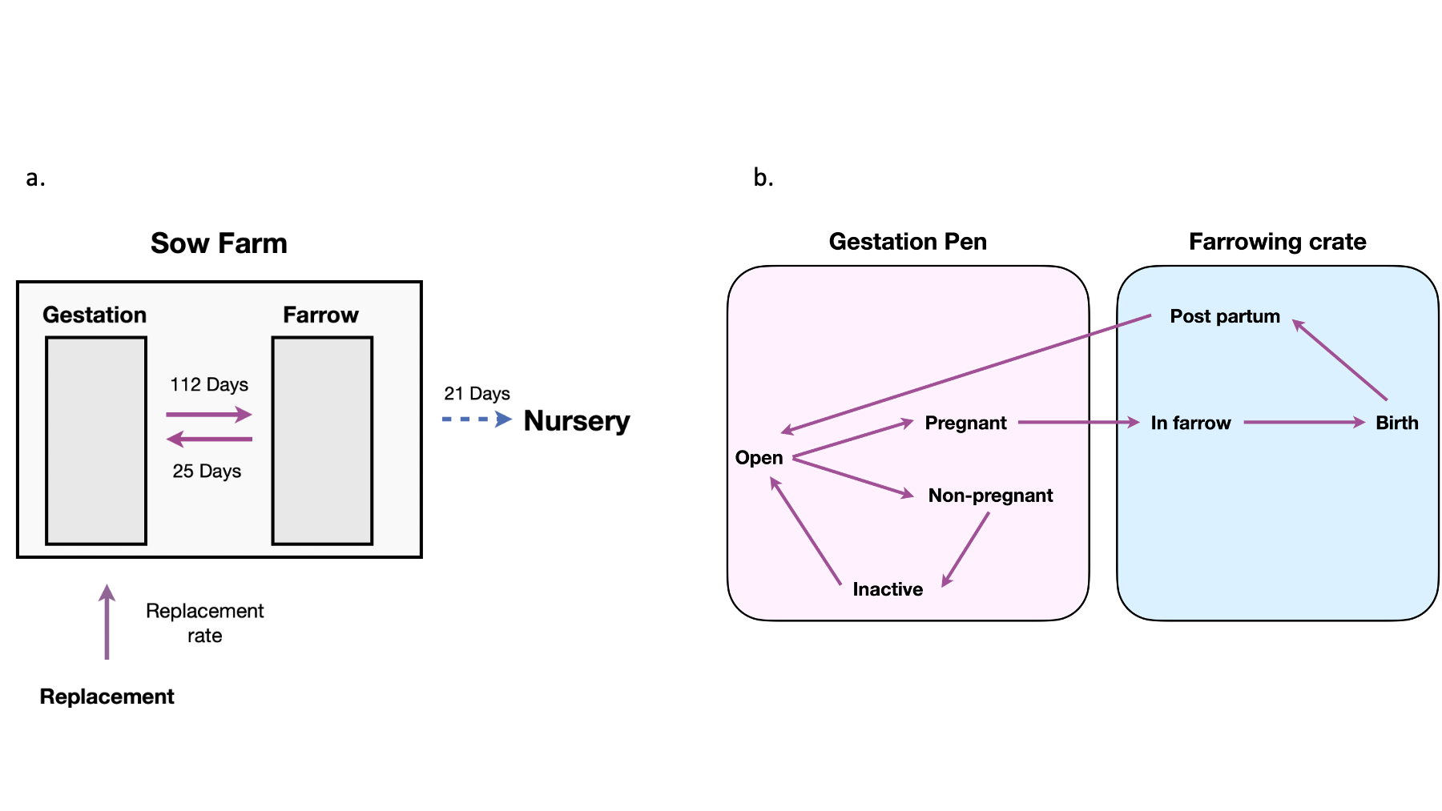
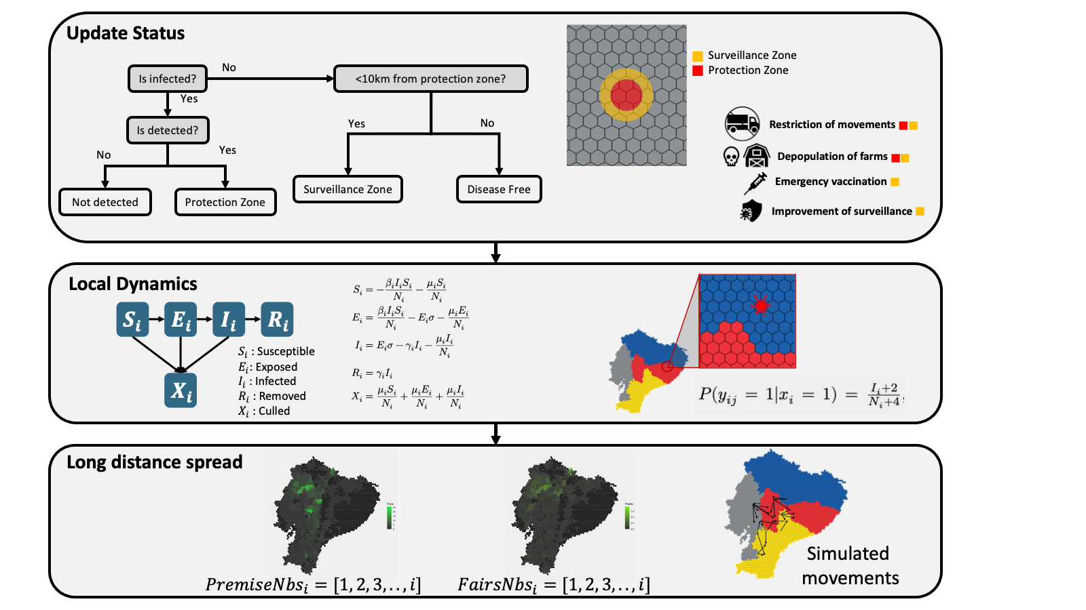
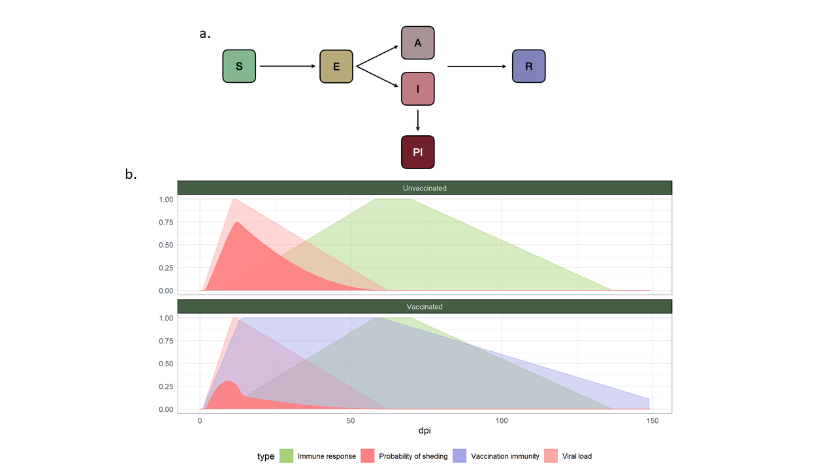
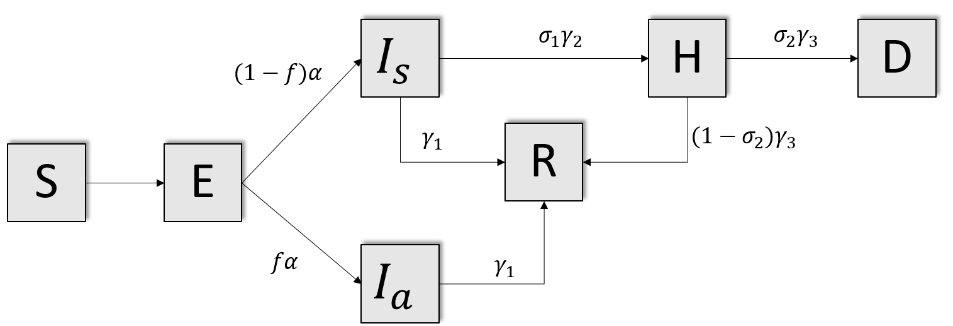
DVM (2010-2015)
MPVM (2016-2017)
PhD (2017-2021)
Notes:
PhD, I knew that I wanted to become more expert in methods, still interested in Epi, but I wanted to become better at the theory and applications
- TA positions (Stats and spatial analysis)
- VMTH consulting one of favs, helped me to think more about stats and translate that to less-stats technical researchers.
- Main work was ABM development
- Complex systems
- Mixed methods

Slide 3

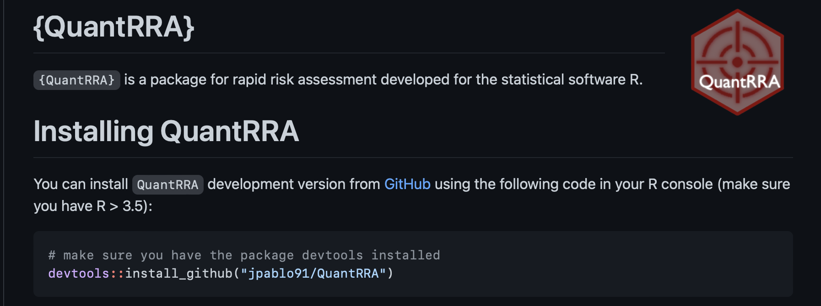
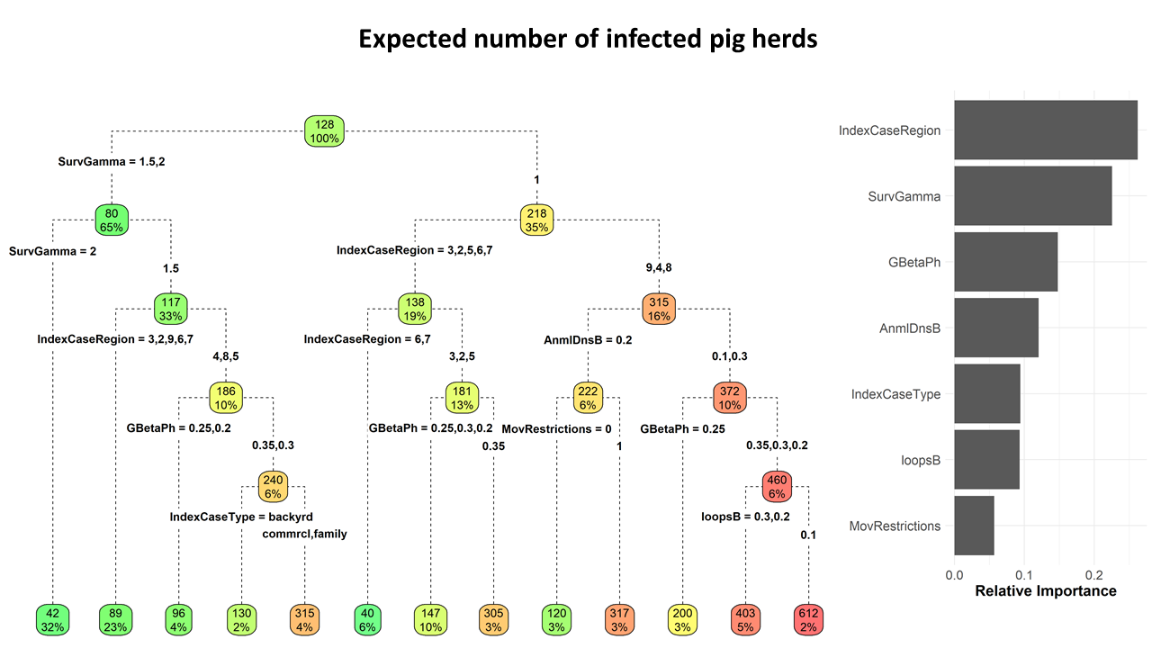
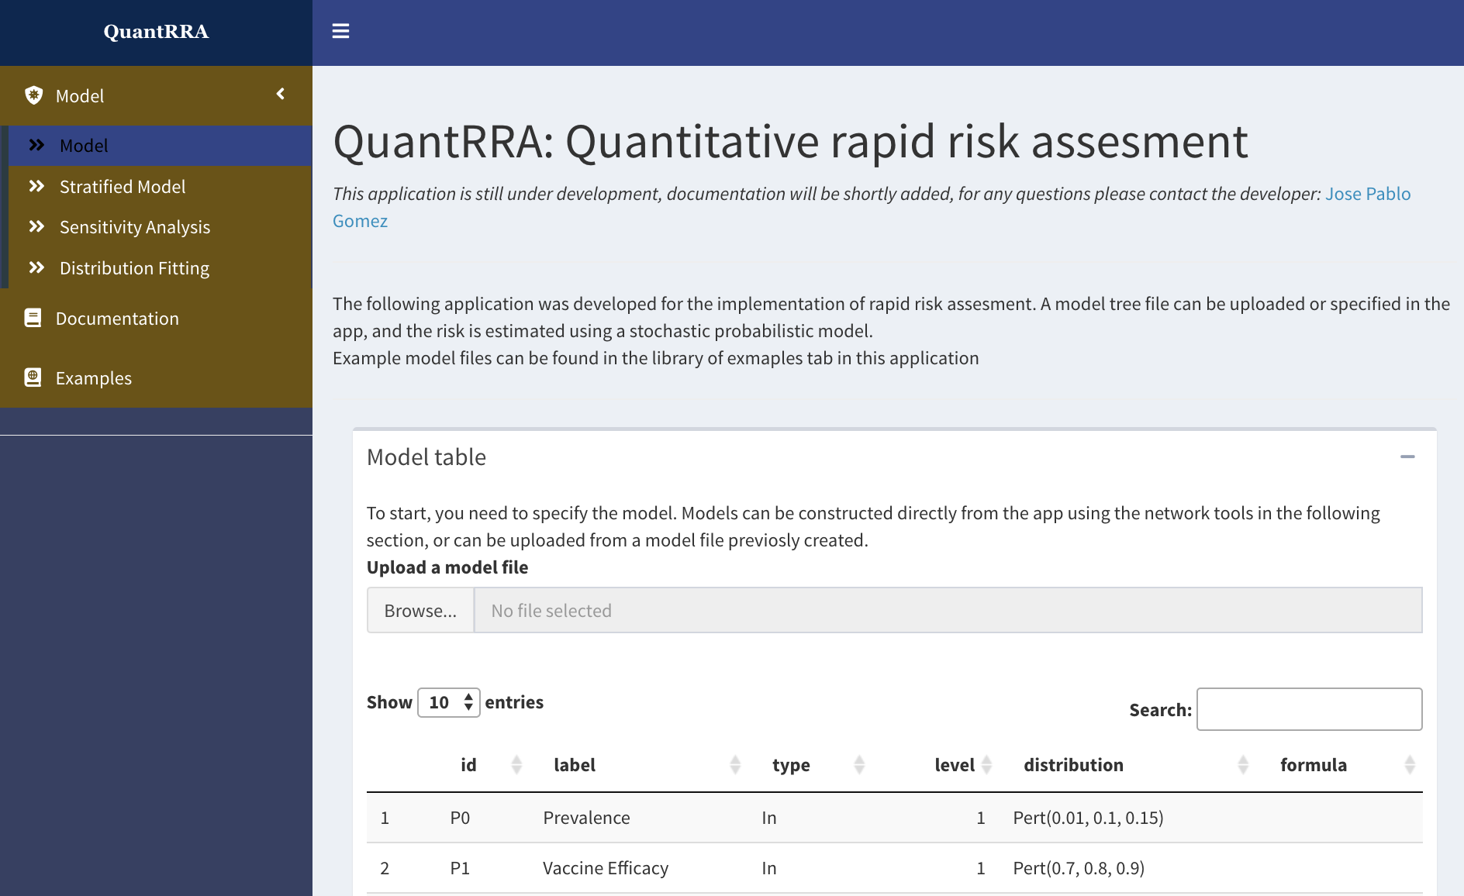
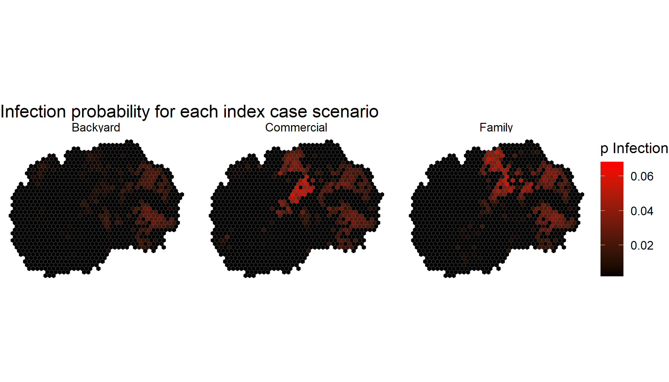
DVM (2010-2015)
MPVM (2016-2017)
PhD (2017-2021)
Post-Doc (2022-current)
Notes:
Post PhD
- Risk assesment package, alternative to paid software like @Risk, implemented in R and for non-coders with a shiny interface
- Implementing models in other regions (Africa and Trinidad and tobago)

Slide 4
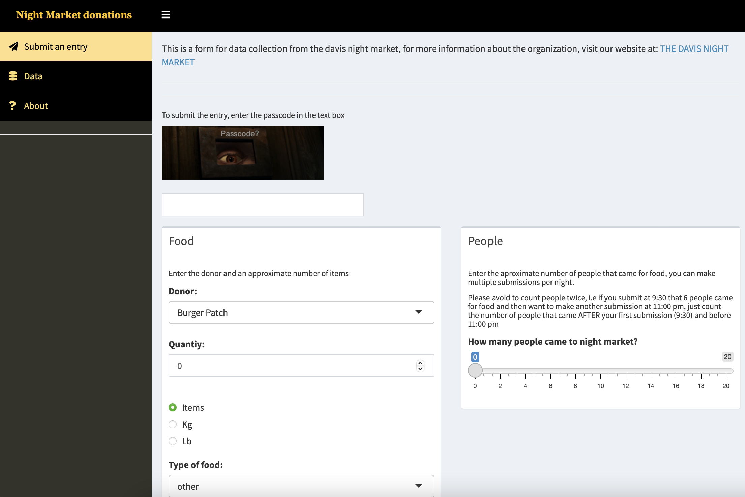
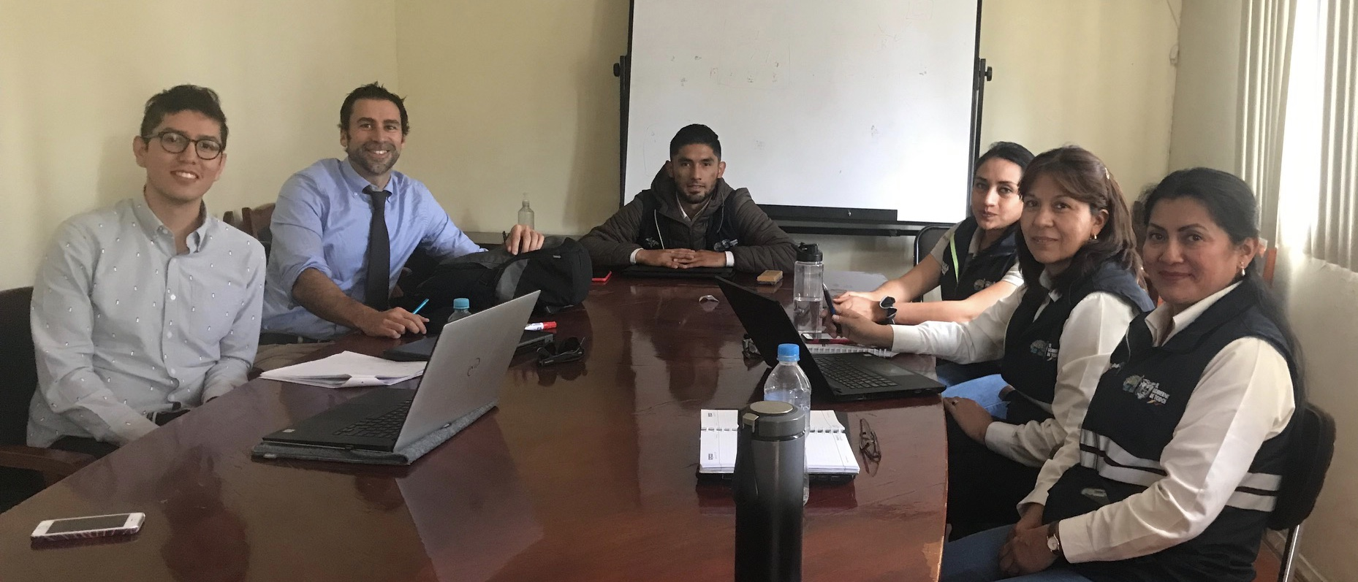
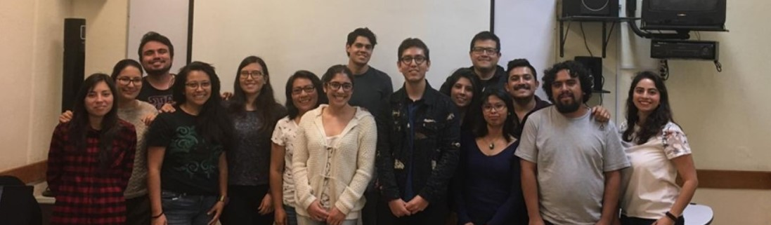
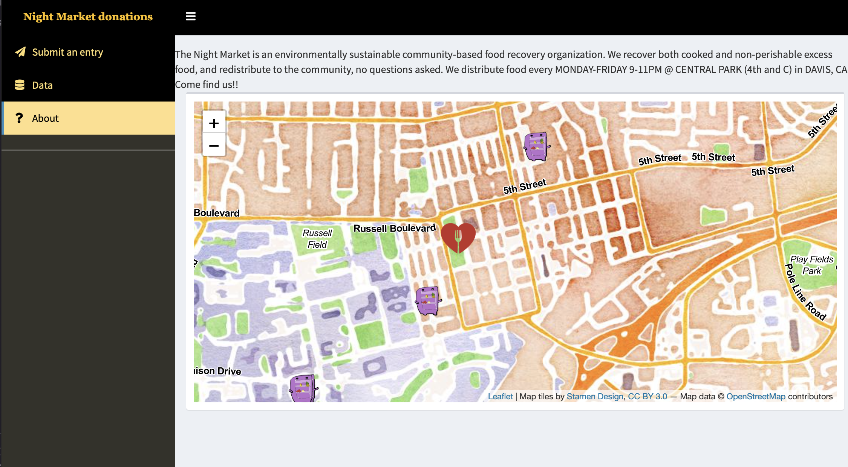
Notes:
- Other stuff:
- I enjoy teaching, so I have a couple of workshops for data visualization, analysis, spatial and network analysis and development of dashboards using Shiny. Workshops have been offered for both academic and not academic institutions in different countries
- I also have been doing some volunteer work with local organizations, I developed some tools for data collection, visualizaition and mapping locations
Relevant skills and experience
How these fit the position requirements and EHA general mission
Last couple of years I have been focusing on methods, which I still want to keep growing on that area, but I also want to apply this methods to things I care.

